Slide 1

We have come to save humans from Digital Experiences that suck

Slide 2
HEAT meet
Hypothesis Exploration And Triangulation meeting
2023-01-12

Slide 3
Goal of this workshop
Find and define new experiments with high potential
Ideas will be collected, summarized and scored (for prioritization)
Go into our hypothesis/idea backlog

Slide 4
1
Background data & insights
2
Hypothesis generation
3
Share
Agenda
4
Sketch solutions
5
Share
6
Wrap-up!

Slide 5
Background data & insights
(10 min)

Slide 6
Focus area: ---
Example: Checkout

Slide 7

Data data

Slide 8
Exercise: Hypothesis generation
(5 min)

Slide 9
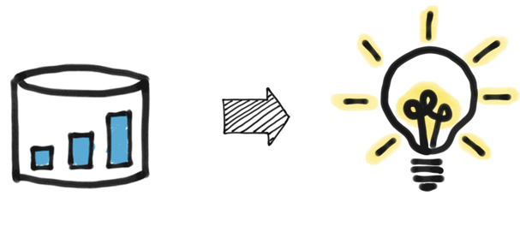
Hypothesis generation (5 min)
Keywords are good enough, and the hypothesis should fit on a post-it note

Slide 10
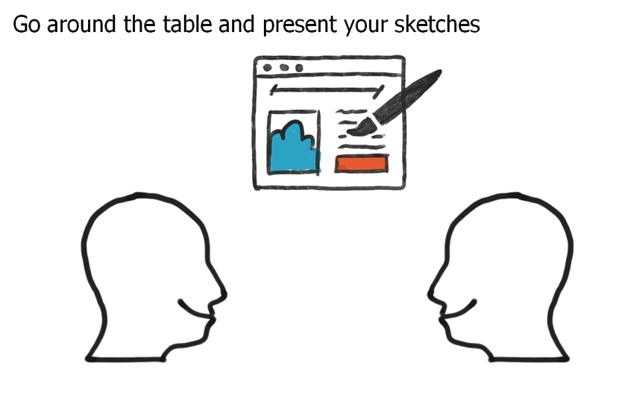
Share hypotheses
(10 min)

Slide 11
Exercise: Sketch solutions
(10 min)

Slide 12
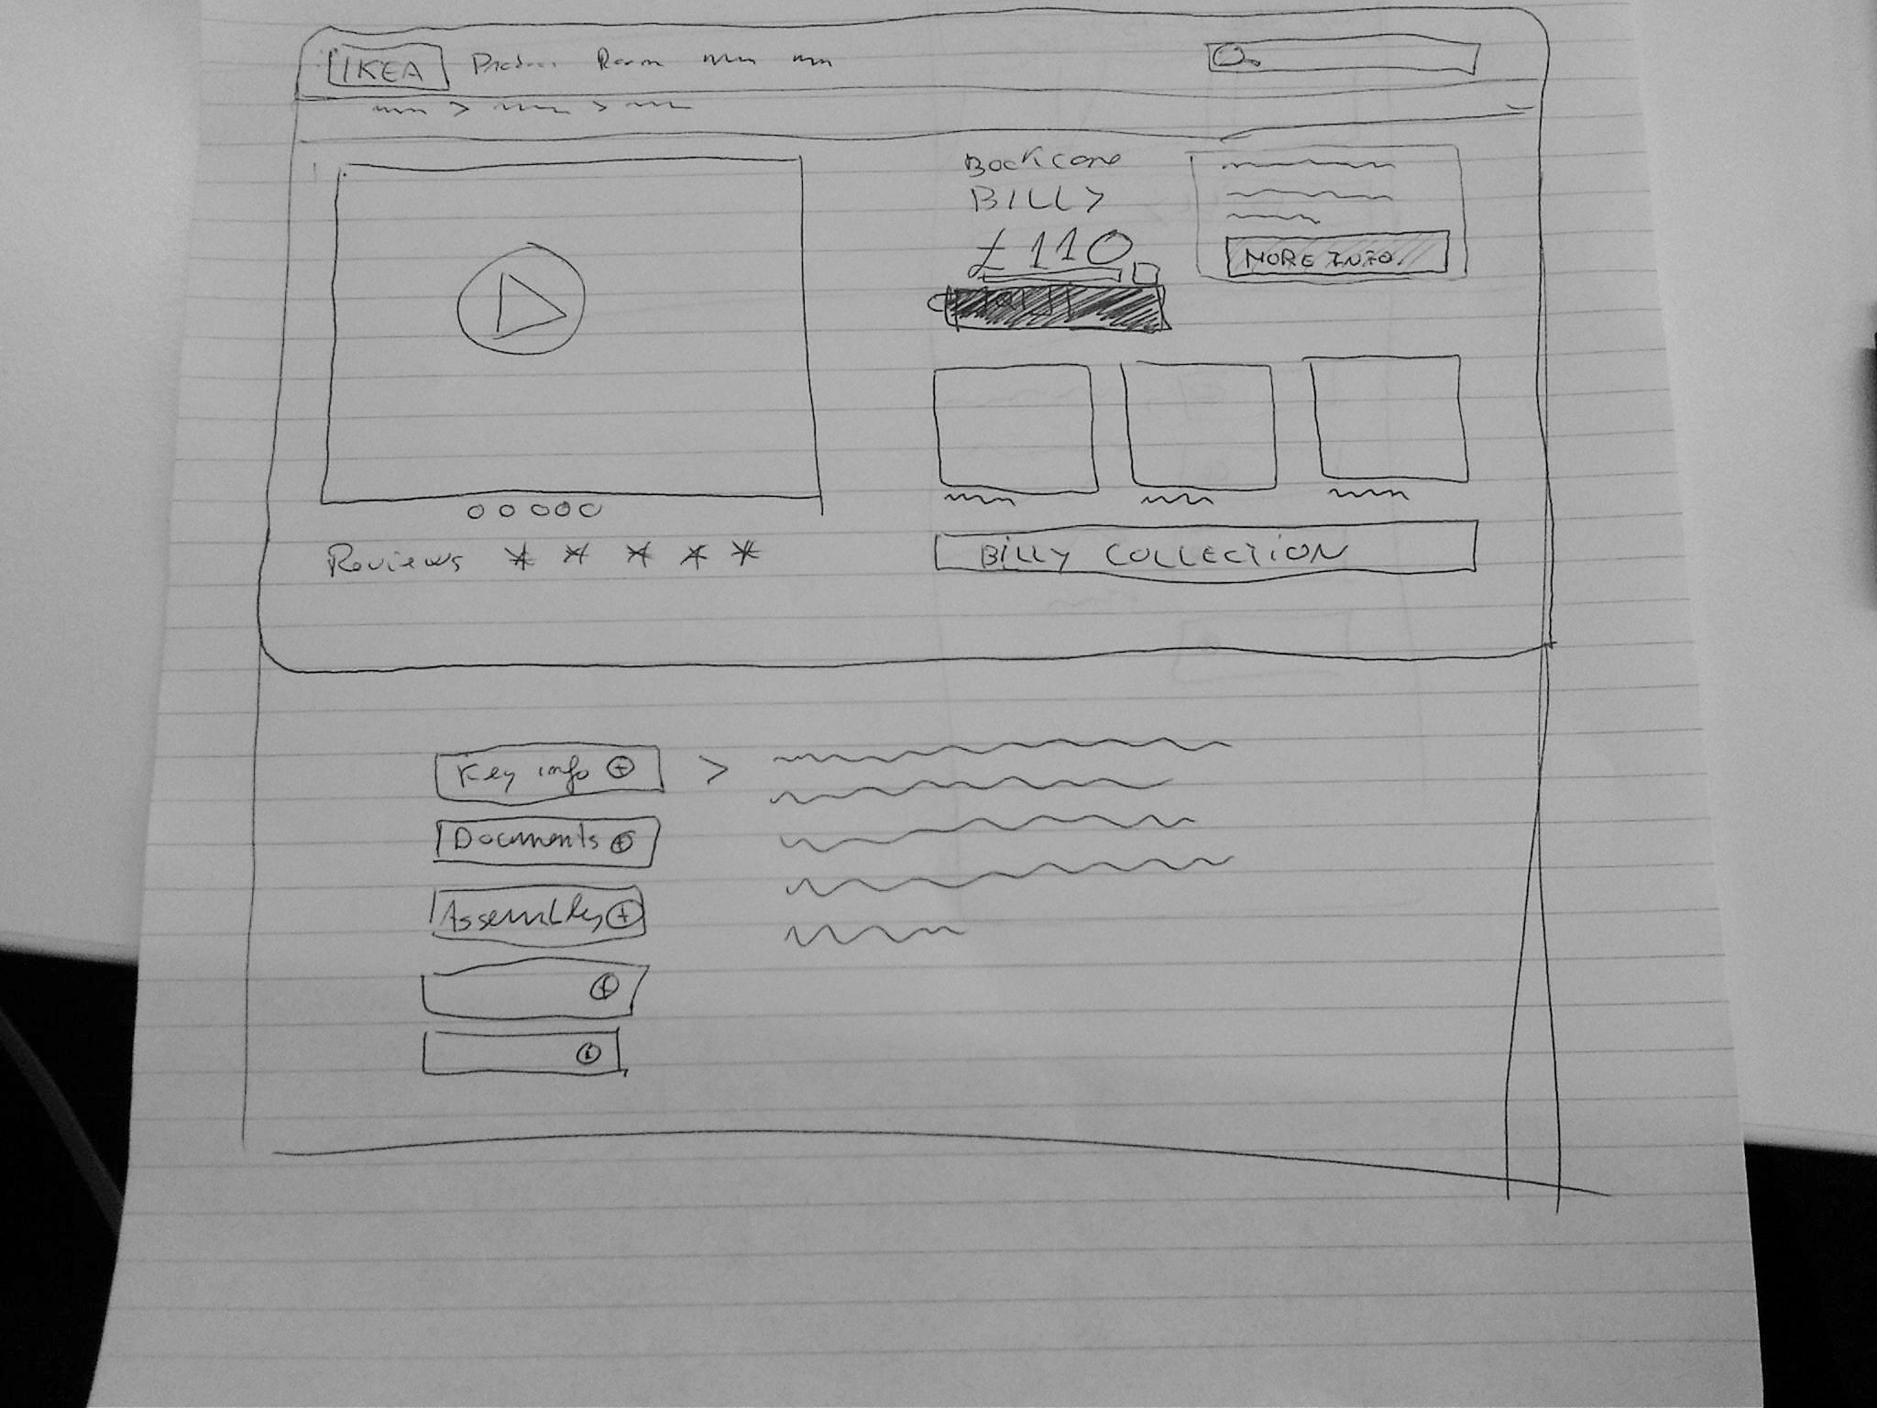
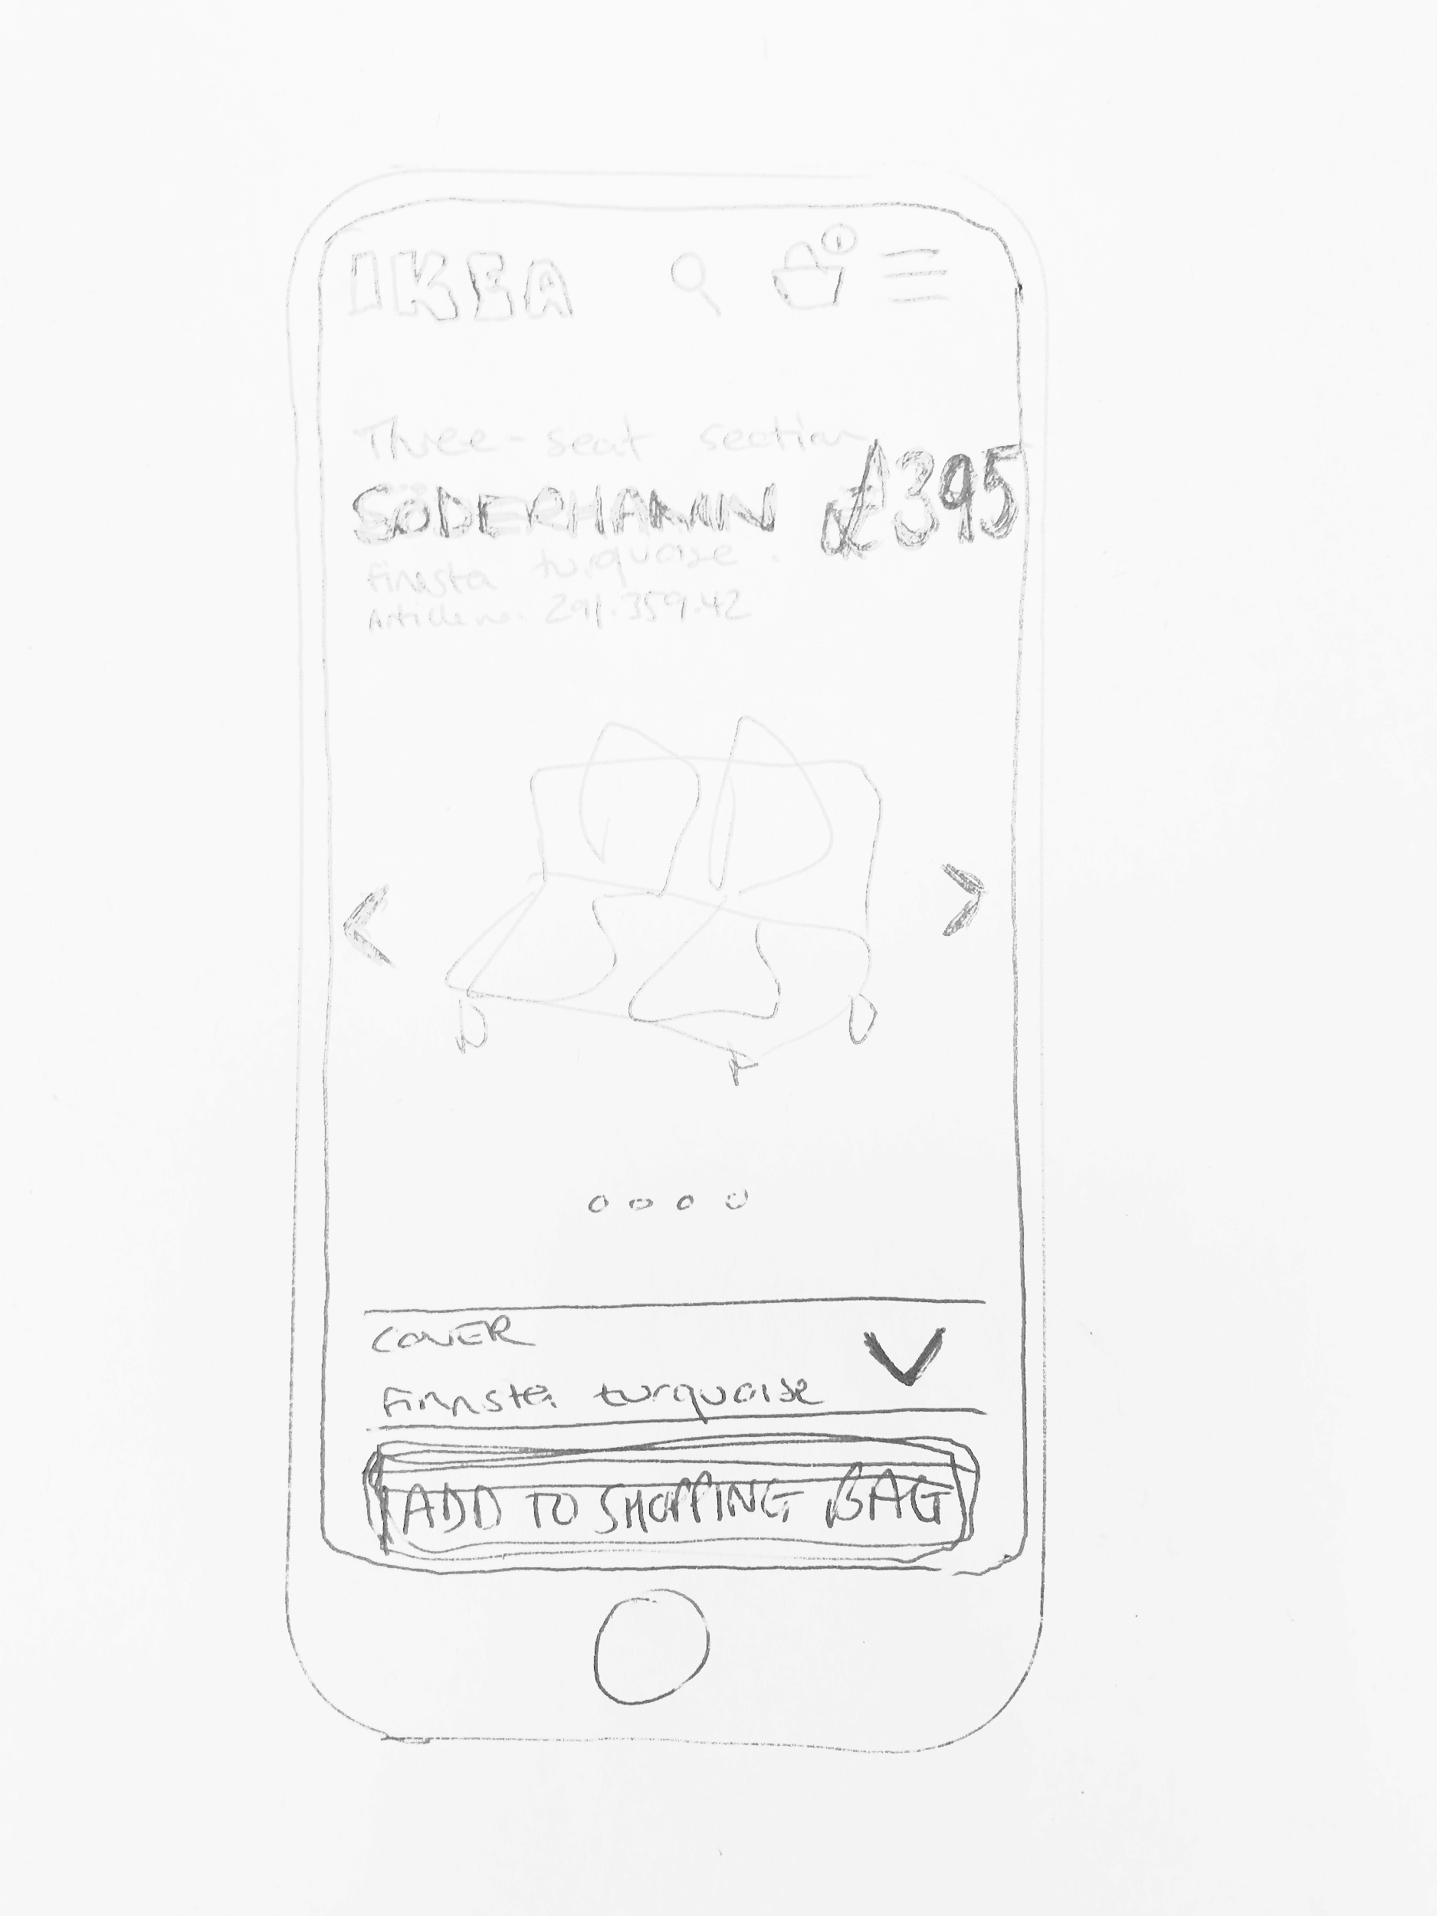
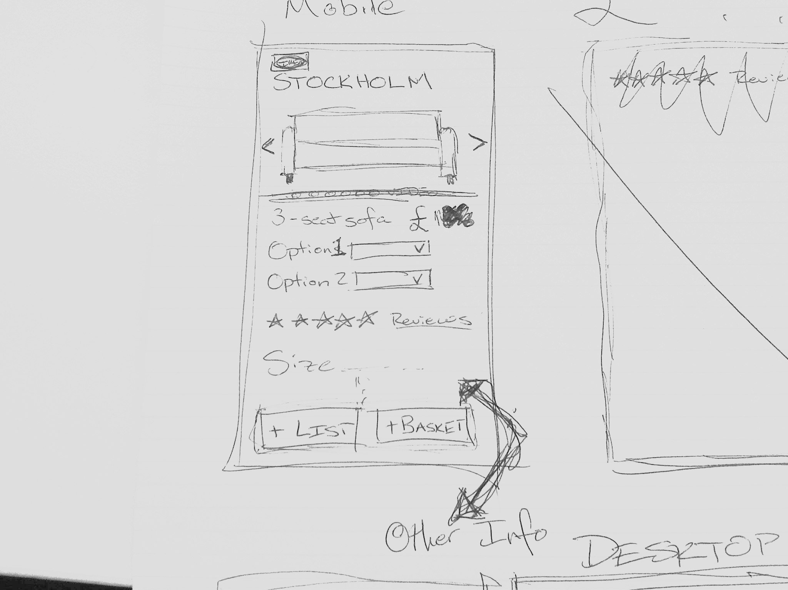

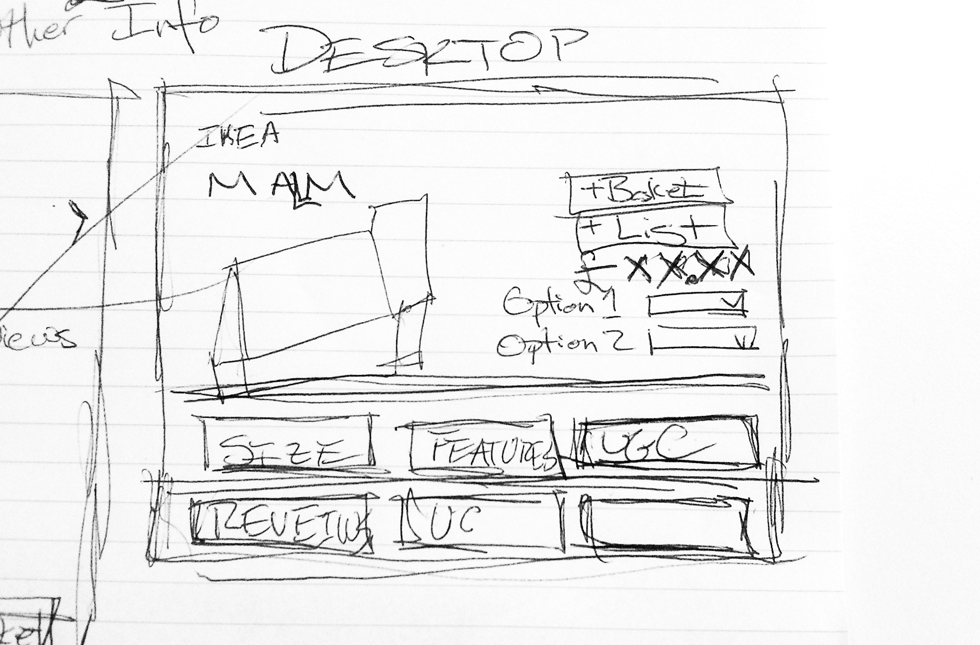
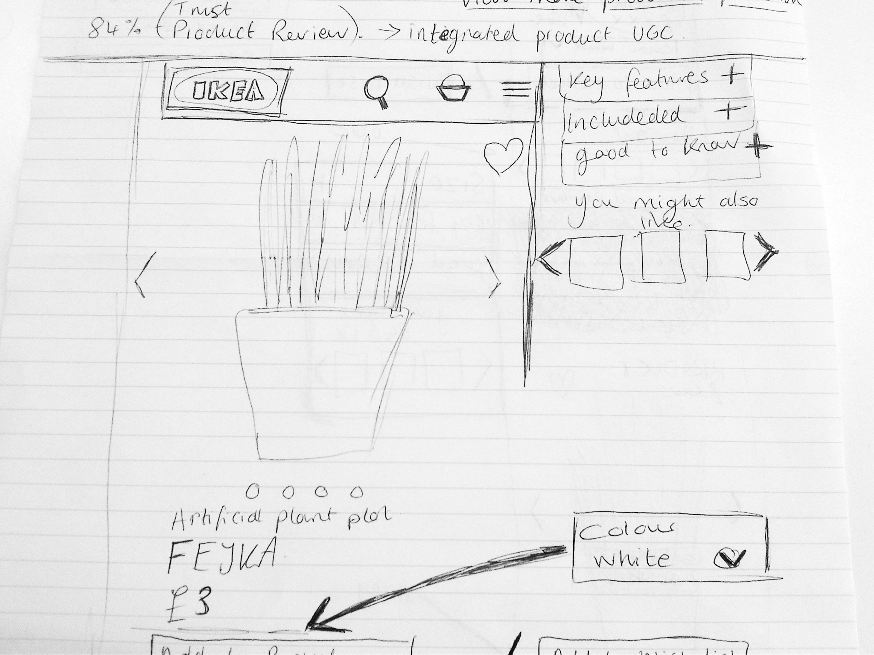
Sketch solutions (10 min)
To encourage creativity and go towards a more concrete solution to your hypothesis, we will now sketch a rough solution to your hypothesis
Don’t worry, this is not an art competition :-)
And don’t be afraid to ask for feedback from the person sitting next to you!

Slide 13
Share solutions
(15 min)

Slide 14
Thank you!

